Slide 1
SDLC

Slide 2
Attack patterns of hackers can be grouped into following
Unauthorized release of privileged information, like accessing confidential documents or stealing credit card number
Unauthorized access to resource, like making free telephone call or stealing money from bank account
Unauthorized modification of privileged information, like modifying examination grade cards
Denial of service, like stopping some service from its legitimate operation

Slide 3
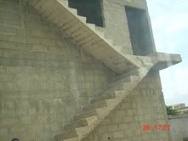
Anything Noteworthy?

Slide 4
Does it Tell any Story?

Slide 5
Functional vs Non-functional
Functional Requirement
Thought (planned)
Non-Functional Requirement
After-thought (not-planned)

Slide 6
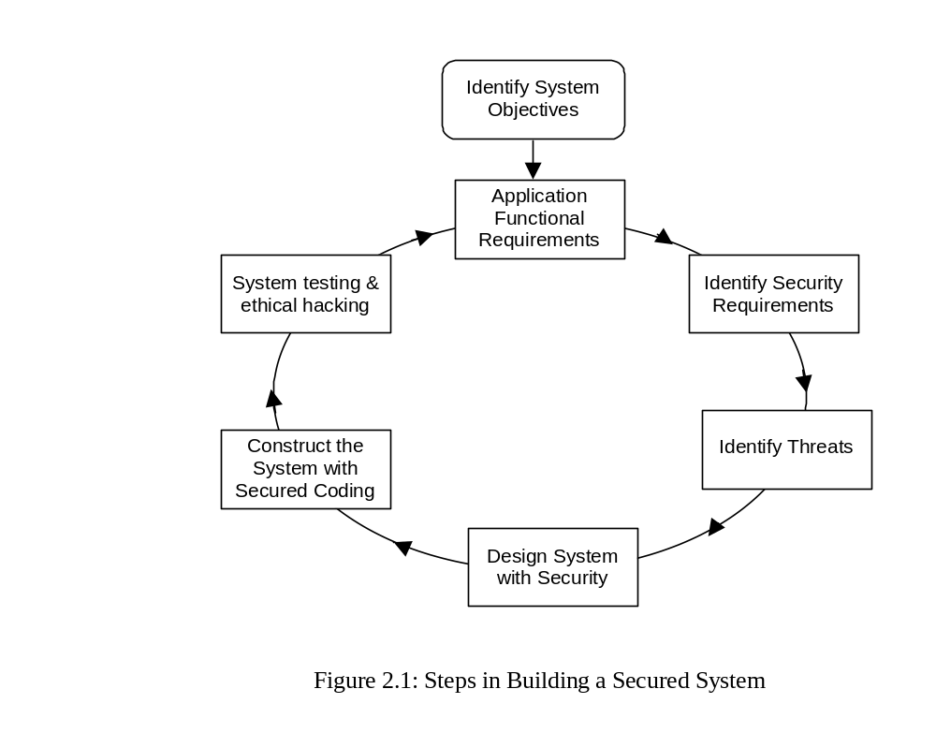
Steps in Secured System Architecture

Slide 7
Building a Secured System
Security Development Lifecycle
  Security Requirement Analysis
  Security Design
  Secure Programming
  Security Testing
  Secured Deploment

Slide 8
Security Objectives
Identity: Does the application protect users’ and customers’ identity and personal information from abuse and theft?
Financial: Assess the level of financial risk the organization may undergo due to security lapse. This could be in terms of lost revenue or lost opportunity.
Proprietary and Sensitive data: Assess the perceived impact if some of the proprietary (intellectual property) or sensitive information (in case of defense) is leaked.
Property and Life: Does damage to any asset has direct or indirect impact on property of life.

Slide 9
Security Objectives
Reputation: Quantify or estimate of the loss of reputation or damage of a brand derived from the application being misused or successfully attacked.
Privacy and Regulatory: To what extent will the application have to protect user and public data?
Availability Guarantees: Is there any service level agreement or assurance on quality of service?
Regulatory: In every country there are certain laws and regulations an enterprise is to honor, respect, and abide by. Does the security threat challenge any of them?

Slide 10
Security Requirement Analysis
Functional versus non-functional requirements
Functional requirement through Use Case
Non-functional requirement through Misuse Case
Co-representing Use and Misuse Cases
Defining the Security Requirements

Slide 11
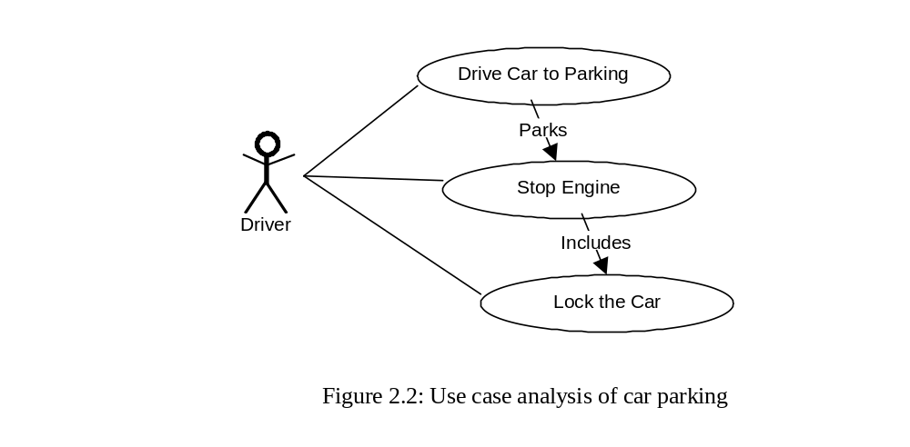
Use Case

Slide 12
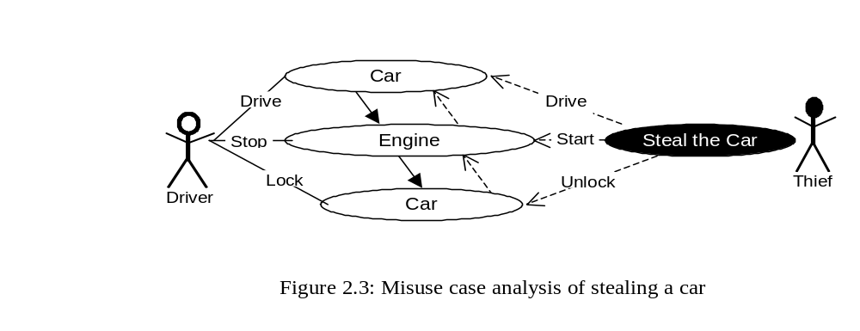
Misuse Case

Slide 13
E-Commerce Misuse Case
Block
repeated
prevents
detects
registration.
Flood
extends
system
Customer
Browse
catalog
includes
Steal
Register
card info
Crook
customer
includes
extends
includes
Tap com
-
prevents
munication
Order
goods
Encrypt
includes
includes
Change
Obtain
Operator
password
passwd
extends
prevents
detects
Enforce
includes
password
includes
regime
Log on
includes
Monitor
system

Slide 14
Define Security Requirement - Step 1
First concentrate on the functional requirements through normal actors and the main use cases requested by these actors, i.e., the services that the users want. Describe actors and use cases in the conventional way suggested by UML methodology, regardless of any security considerations.

Slide 15
Define Security Requirement - Step 2
Next step is to look at security related misuse-cases. Introduce the major mis-actors and misuse cases. Consider all likely threats for your system. You need to use techniques like threat modeling (described below) for this activity. Identify all likely mis-actors with their precise names. For example, if your company has a special concern that your competitors might be involved in industrial espionage and attack your computer, this mis-actor could be called competitor. This will give a better perspective to the mis-actor’s motivation.

Slide 16
Define Security Requirement - Step 3
Now you investigate the potential relations between use cases and misuse cases, in terms of potential “includes”-relations. This step is quite critical; because, there are many threats to your system that can largely be achieved by exploiting system’s normal functionality – for instance the “Flood system” misuse case in the above example (Figure 2.4).

Slide 17
Define Security Requirement - Step 4
This is a very important step, look at security related non-functional requirements as functional requirement. Introduce new use cases that are necessary to create with the purpose to detect or prevent misuse cases. For example, you may like to add a use-case called “throttle” to prevent the “flood system” use case.

Slide 18
Define Security Requirement - Step 5
Continue with above four steps with more and more refinements and detailed requirements documentation.

Slide 19
Assets
This is the object that we need to protect. There is a value attached to an asset. The value may vary from context to context, organization to organization. The asset can be tangible like money in case of a bank or intangible assets like the brand or reputation of a company. Asset can also relate to assets of your customers, partners, or employees. Defense strategy to protect an asset will depend on the value of this asset and its importance to an organization.

Slide 20
Vulnerabilities
These are weaknesses in the system. Most of the time this are due to lack of proper defense mechanism or security bugs. Vulnerabilities can be anywhere – starting from the user program to operating system, networks, databases, or even internal staff. A vulnerability can be exploited to launch a security attack.

Slide 21
Threats
Possible occurrence of an undesirable event. If the undesirable event occurs it causes damage to assets, objects, or even life. If there is vulnerability, it might potentially be a threat. Threat always relate to some assets.

Slide 22
Exploits (or Attacks)
When a threat becomes reality, it is called attack. These are actions taken by adversaries to launch security attacks on assets. Attacks generally launch attacks for profit or just fun by exploiting vulnerabilities in the system.

Slide 23
Countermeasure
These are measures to eliminate vulnerabilities or reduce the attack surface. Countermeasure can also relate to limiting the impact of the attack. Countermeasures can span from installing firewall, improving operational practices, improving application design, to improving the code

Slide 24
Threat Modeling
STRIDE
Attack Tree
DREAD
Attack Surface
Putting All Together

Slide 25
STRIDE
Spoofing Identity
Tampering with Data
Repudiation
Information Disclosure
Denial of Service
Elevation of Privilege

Slide 26
Spoofing Identity
In a spoofing attack, an adversary impersonates as a different person and pretends to the system as a legitimate user. Spoofing attack is mitigated through authentication so that adversaries can not become any other user or assume the attributes of another user.

Slide 27
Tampering with Data
Any data to the application or from the application should be secured so that it can not be altered. The application should validate all data received from the user before storing or using it for any processing. An attacker should not be able to change data delivered to a user. Also, data in the disk and any other storage media needs to be protected.

Slide 28
Repudiation
A dishonest users may dispute a genuine transaction if there is insufficient auditing or recordkeeping of their activity. For example, a bank customer may says, “The signature on the check is forged and the money should be credited in my account!”, and you cannot track his or her activities through the application. In such case it is likely that the transaction will have to be written off as a loss. Therefore, applications need to have audit trails and systems by which the activity of a user can be proved beyond doubt. If necessary this can also be proved within the purview of court of law.

Slide 29
Information Disclosure
If it is possible for an attacker to publicly reveal user data, whether anonymously or as an authorized user, there will be an immediate loss of confidence and reputation loss. Also, disclosure of proprietary or secured information may lead to serious financial loss. Therefore, applications must include strong controls to prevent disclosure of information.

Slide 30
Denial of Service
Application designers should be aware that their applications may be subject to a denial of service attack. Therefore, countermeasures for such attack should be properly built in the system.

Slide 31
Elevation of Privilege
If an application provides distinct user and administrative roles, then it is vital to ensure that the user cannot elevate his role to a higher privilege one. All actions should be gated through an authorization matrix, to ensure that only the permitted roles can access privileged functionality. Also, the privileged access must be for the minimum duration it is necessary.

Slide 32
Attack Tree
Attack tree is a tool to evaluate the system security based on various threats. Various vulnerabilities and compromises are used to build the attack tree.
The root of a tree represents a security event that can potentially damage an asset.
Each attack tree enumerates ways an attacker can cause an event to occur.
Each path through an attack tree represents a unique attack.
A system can have a forest made up of many such attack trees.

Slide 33
Attack Tree decomposition
You decompose a node of an attack tree either through an AND-decomposition or an OR-decomposition.
AND-decomposition comprises of a set of attack sub-goals; where, all of which must be achieved to succeed. AND-decomposition is where the attacker can achieve goal G₀ only when all goals G₁ through G_{N} are successful.
OR-decomposition is a set of attack sub-goals; where, at least one of the sub-goals needs to be achieved to succeed. OR-decomposition is where the attacker can achieve goal G₀ if the attacker achieves one of any goals from G₁ to G_{N}.

Slide 34
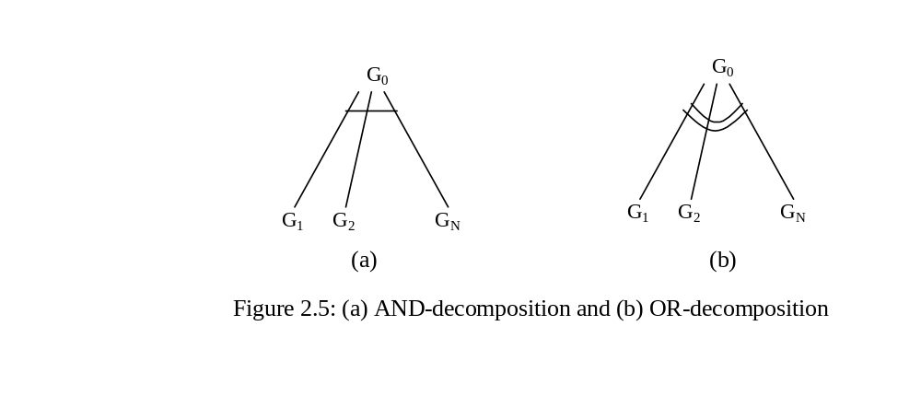
Attack-tree Terminology

Slide 35
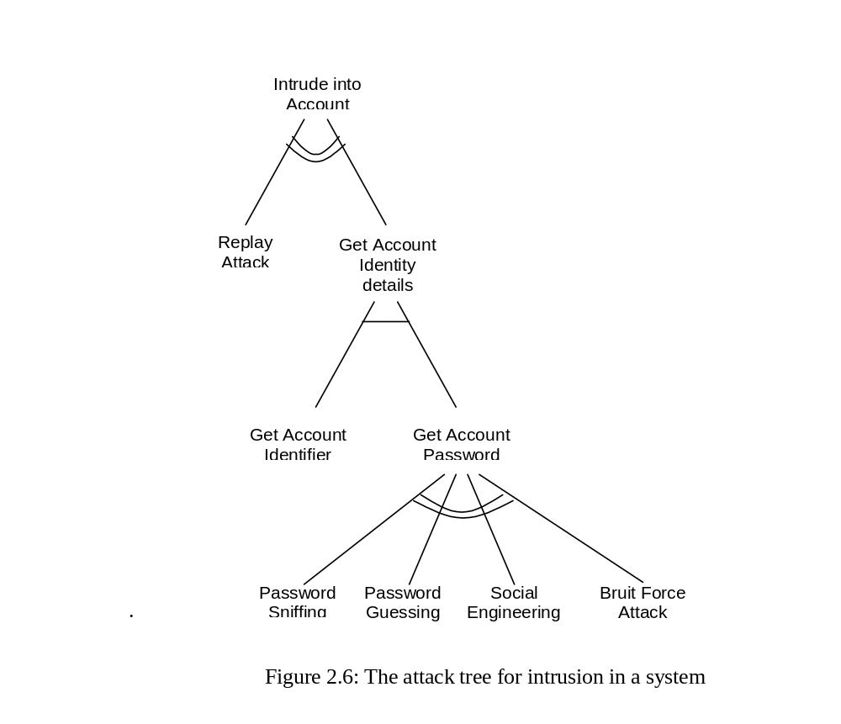
Attack-tree for Authentication Attack

Slide 36
DREAD
DAMAGE
REPRODUCIBILITY
EXPLOITABILITY
AFFECTED USERS
DISCOVERABILITY

Slide 37
Damage Potential
If a threat exploit occurs in reality, how much damage will it cause?
  0 = Nothing
  5 = Individual user data is compromised or affected.
  10 = Complete system or data destruction

Slide 38
Reproducibility
How easy is it to reproduce the threat exploit?
  0 = Very hard or impossible, even for administrators of the application.
  5 = One or two steps required, may need to be an authorized user.
  10 = Just a web browser and the address bar is sufficient, without authentication.

Slide 39
Exploitability
What tool is needed to exploit this threat?
  0 = Advanced programming and networking knowledge, with custom or advanced attack tools.
  5 = Malware exists on the Internet, or an exploit is easily performed, using available attack tools.
  10 = Just a web browser

Slide 40
Affected Users
How many users will be affected?
  0 = None
  5 = Some users, but not all
  10 = All users

Slide 41
Discoverability
How easy is it to discover this threat?
  0 = Very hard to impossible; requires source code or administrative access.
  5 = Can figure it out by guessing or by monitoring network traces.
  9 = Details of faults like this are already in the public domain and can be easily discovered using a search engine.
  10 = The information is visible in the web browser address bar or in a form.
When performing a security review of an existing application, by normal convention “Discoverability” is set to 10; because, it is assumed that threat issues will always be discovered. You can customize DREAD by adding finer granularity or new definition of weightage.

Slide 42
Risk rating
Risk_DREAD = (DAMAGE + REPRODUCIBILITY + EXPLOITABILITY + AFFECTED USERS + DISCOVERABILITY) / 5

Slide 43
Attack Surface
If you want to attack an enemy target, the target must be visible or exposed. This is precisely the reason of using bunkers and trenches in a war.
In the battlefield, soldiers camouflage an object to prevent it from air-attack or other types of attack. One of the best strategies of defense therefore, is to hide an object from public view. By hiding and object you reduce the attack surface.
ANYBODY CAN HIT A LARGE BULL’S EYS

Slide 44
Attack Surface
In computers, only that part of the program can be a target of attack that is accessible to an attacker. A piece of code or part of a program is exposed to the public through user interface or an API; this can be target of attack. The attack surface of an application is the union of code, interfaces, services, protocols, and practices exposed to a user (or attacker alike). In security design therefore, always the attempt is to analyze the attack surface and reduce it. If the attack surface is reduced, the risk of attack also reduces.
Attack surface reduction focuses on reducing the area of the code accessible to unauthorized users. You achieve this by understanding the system’s entry points and the trust level required to access them through authentication and authorization checks.

Slide 45
Attack Surface Question 1
Is this feature really necessary? Who are the users that need this feature? If this feature is not necessary by majority of users, it should be unavailable by default.

Slide 46
Attack Surface Question 2
Is it necessary to offer this feature from remote location? If yes, determine where from and what type of access mechanism this feature will be provided. Also, determine the type of networks the feature will be available from?

Slide 47
Attack Surface Question 3
Who are the users that need to access this feature? You need to determine the legitimate users and a mechanism to validate them so that unauthorized users cannot access this feature?

Slide 48
Attack Surface Question 4
What type of privilege does this feature need to provide the service? If it needs escalated privilege, determine how long it needs the escalated privilege for?

Slide 49
Attack Surface Question 5
What are the interfaces this feature has with other services, interfaces, and protocols? If this feature crashes, what impact it will have on other services or the system as a whole.

Slide 50
Putting All together
System Objective
Functional
Requirement
Identify Assets
Use case analysis
STRIDE
Misuse case
analysis
Attack Tree analysis
DREAD
Reduce Attack Surface
Figure 2.7: Security requirements analysis lifecycle

Slide 51
Putting All together
Step 1: At the very first step you identify system objectives.
Step 2: Analyze functional requirements of the system using use case and UML tools.
Step 3: List down system’s security requirements and security objectives. Here you may like to use the STRIDE tool. You may also like to combine other security attributes like CIAAAA (Confidentiality, Integrity, Availability, Authentication, Authorization, Accounting) to ensure that security objectives are met.
Step 4: List down the assets the system is handling and risk associated with them. This will include all tangible and intangible assets starting from financial to regulatory.
Step 5: Use misuse-case to analyze security risks and interactions between different tasks and their relationship.
Figure 2.7: Security requirements analysis lifecycle

Slide 52
Putting All together
Step 6: Use attack tree to breakdown misuse cases to understand what are the AND and OR components in the threat path. You need to look at each and every OR component; but possibly can manage with only the cheapest AND component.
Step 7: Use DREAD tool to rate these threats. Add some price to these threats and then compare with your asset. If it is too expensive to secure an asset compared to the cost of the asset, you may let is go as “loss due to fraud”. You can also use DREAD tool to prioritize the threat mitigation plan. You may like to refine it further by iterating it through step 5 and 6.
Step 8: Analyze the attack surface and consider reducing the attack surface. To reduce the attack surface, you may like to analyze it further and go back to step 5, 6, or 7 based on the situation and criticality.
Step 9: Progressively refine the requirements by decomposition of the requirements – for this you may like to iterate from Step 2.
Figure 2.7: Security requirements analysis lifecycle

Slide 53
Security Design
Patterns and Anti-Patterns
Attack Patterns

Slide 54
Attack patterns
A pattern can be defined as a repeatable model which can be used to define an element within a system. In loose term, a pattern can be defined as a class in a computer language. In this section, we define attack patterns. An attack pattern characterizes an individual attack type that an adversary may use for some malicious intension. Each attack pattern contains following sections,

Slide 55
Pattern Sections
Pattern name and classification
The overall goal of the attack specified by the pattern
A list of preconditions for its use
The steps for carrying out the attack
A list of post conditions that are true if the attack is successful
A list of suggestions that can be used to counter this attack

Slide 56
Pattern Name and Classification
Every pattern should have a descriptive and unique name that helps in identifying and referring to it. Additionally, the pattern should be classified according to a classification such as the one described earlier. This classification helps in identifying the use of the pattern.

Slide 57
Also Known As
A pattern could have more than one name. These names should be documented in this section.

Slide 58
Context
In this you define the context in which the pattern will be used or likely to be used. This may also describe the threat scenarios and attack patterns.

Slide 59
Intent
This section should describe the goal behind the pattern and the reason for using it. It resembles the problem part of the pattern.

Slide 60
Motivation
This section provides a scenario consisting of a problem and a context in which this pattern can be used. By relating the problem and the context, this section shows when this pattern is used.

Slide 61
Applicability
This section includes situations in which this pattern is usable. It represents the context part of the pattern.

Slide 62
Structure
A graphical representation of the pattern. Class diagrams and Interaction diagrams can be used for this purpose.

Slide 63
Participants
A listing of the classes and objects used in this pattern and their roles in the design.

Slide 64
Collaboration
Describes how classes and objects used in the pattern interact with each other.

Slide 65
Consequences
This section describes the results, side effects, and tradeoffs caused by using this pattern.

Slide 66
Implementation
This section describes the implementation of the pattern, and represents the solution part of the pattern. It provides the techniques used in implementing this pattern, and suggests ways for this implementation.

Slide 67
Sample Code
An illustration of how this pattern can be used in a programming language

Slide 68
Known Uses
This section includes examples of real usages of this pattern.

Slide 69
Related Patterns
This section includes other patterns that have some relation with this pattern, so that they can be used along with this pattern, or instead of this pattern. It also includes the differences this pattern has with similar patterns.

Slide 70
Security Design Patterns
Single Access Point: Providing a security module and a way to log into the system. This pattern suggests that keep only one way to enter into the system.
Check Point: Organizing security checks and their repercussions.
Roles: Organizing users with similar security privileges.
Session: Localizing global information in a multi-user environment.
Full View with Errors: Provide a full view to users, showing exceptions when needed.
Limited View: Allowing users to only see what they have access to.
Secure Access Layer: Integrating application security with low-level security.
Least Privilege: Privilege state should be shortest lived state
Journaling: Keep a complete record of usage of resource
Exit Gracefully: Designing systems to fail in a secure manner.

Slide 71
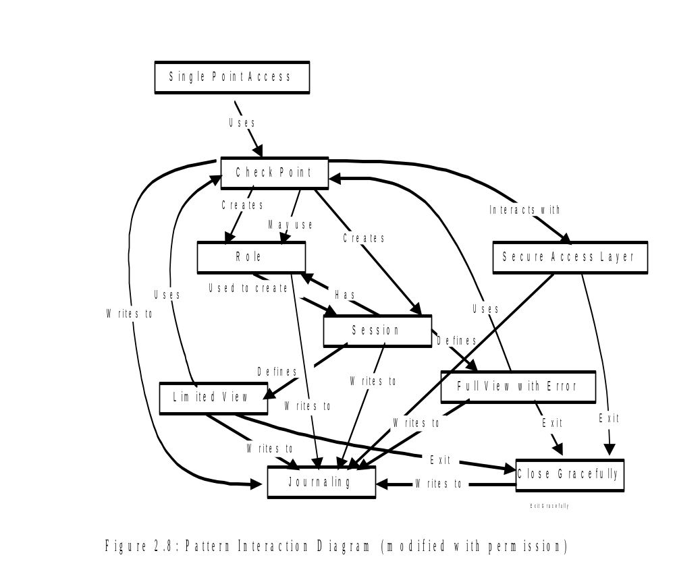
Security Design Patterns

Slide 72
Security Coding
Security Algorithms
  Symmetric Key Cryptography
  Public Key Cryptography
  Secret Sharing and Threshold Cryptography
  Digital Signature

Slide 73
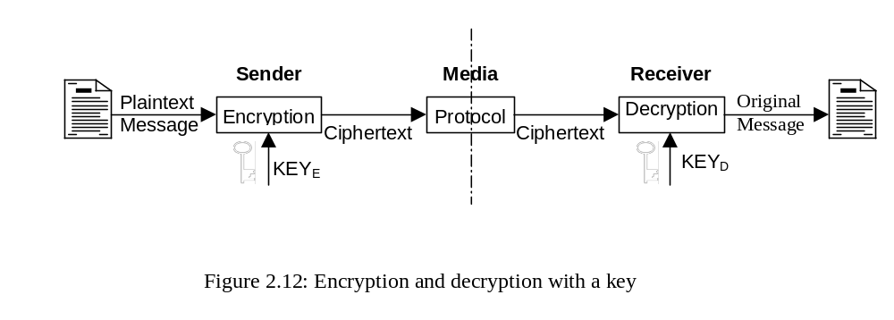
Cryptography

Slide 74
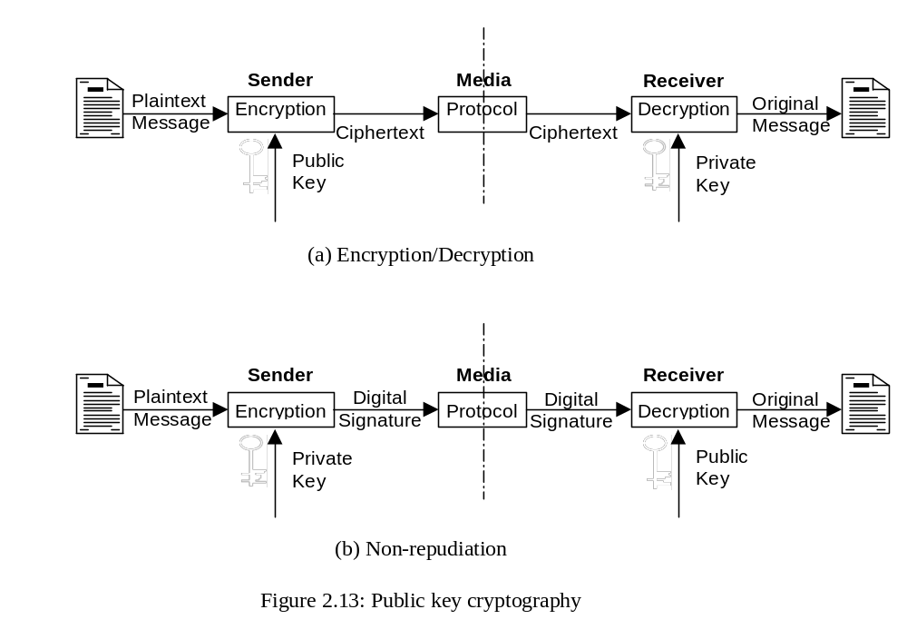
Public Key Cryptography

Slide 75
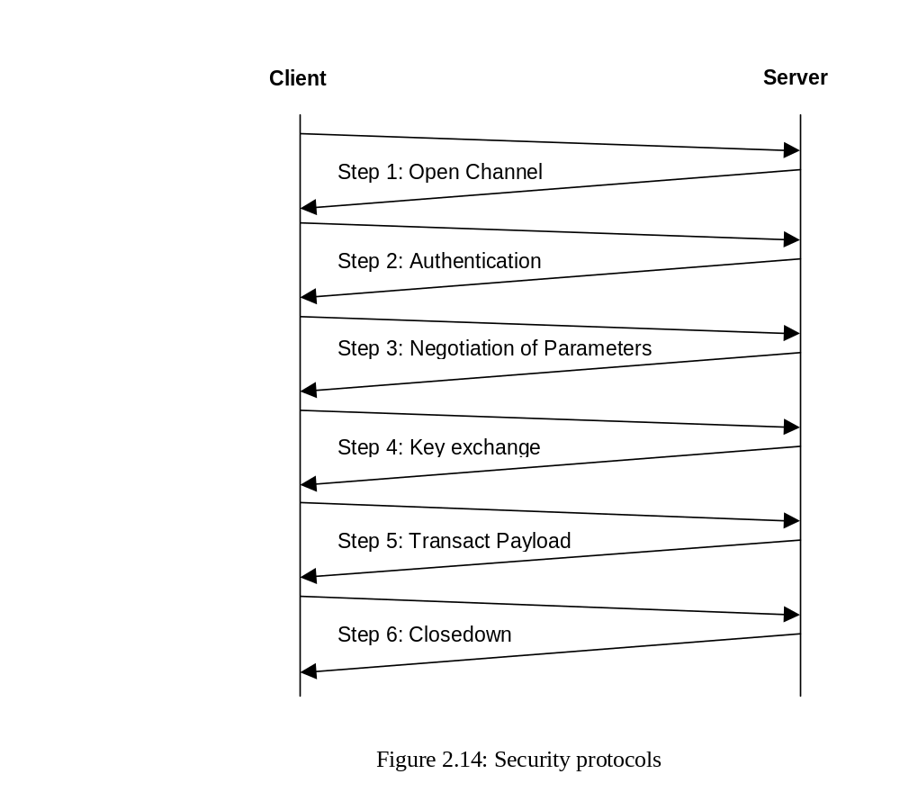
Security Protocol

Slide 76
Security Coding
Security Protocol
Key Generation
Key for Symmetric Cryptography
Key for Public Key Cryptography

Slide 77
Security Coding
Session Management
Logging And Auditing

Slide 78
Authentication
Delay Authentication Prompt
Encrypt the Password
Strong Password
Prevent Replay Attack on Password
  Onetime Password
Prevent Password Guessing
Multi-key Authentication
Multifactor Authentication
Build a Knowledgebase on Password Usage
Challenge Questions
Pass Sentences and Pass Phrases
Mnemonic Password
Randomize Password

Slide 79
Multifactor Authentication
What you know: This is standard password. In an ATM situation, this is the user’s PIN (Personal Identity Number). Other example of what you know will be Password, Pass Phrase, Answer to some personal questions, Sequence of numbers, Predetermined events etc.
What you have: This is some physical entity or object that the user needs to use during authentication. Example could be your ATM card, a token, magnetic stripe card, private key protected by password, smart card, hardware token, RF badge, Physical key, microchip, etc.
What you are: This is what the user in reality is. These could be various biometric properties that is unique to an individual, Examples could be fingerprint, voice, retinal scan, iris, hand geometry, Face of the user, etc that are unique to a user.

Slide 80
Challenge Question
What is your date of birth?
What is your first school?
What is your mother’s maiden name?
What is your billing address?
What is your pet’s name?
What is your favorite star’s last name?
What is your favorite drink?
What was the date of your last payment?
What is the amount of your last payment?
Check number of your last payment?
What is your graduate school?
When did you graduate?

Slide 81
Pass Sentences & Phrases
“You do not want to know” -- “Udunwant2no”
“I love you for what you are” -- “1lovU4whatUr”
“My daughter Debi is now twenty years old” -- “MydauterDBizNOW20yarZld”
In password it is always advisable that you replace real characters with look-alike characters. For example “i”, “I”, “l”, or “L” with “!” or “1”; “s” or “S” with “$” or “5”, “o” or “O” with “0”; “B” or “b” with “8” or “3”; “a” or “A” with “@”; “D” or “d” with “>”; “to” with “2”; “for” with “4”; “T” or “t” with “+”; “tt” or “TT” with “#”, or replacement characters chosen by you

Slide 82
Multi-key Authentication
In this mode of authentication you use multiple key from the same factor
You could as password with challenge question pr pass phrase etc

Slide 83


Reverse Turing Test

Slide 84
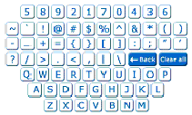
Software Keyboard

Slide 85
Authorization
Role based Security
Access rights based on privilege and role of the user
Define groups with different privileges
Make users members of these groups

Slide 86
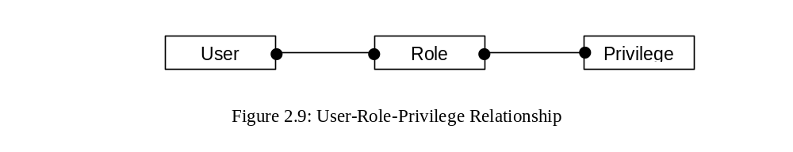
Role

Slide 87
Safe Programming
Safety as a measure at a class level; whereas, security is at an instance level. A safe program will be able to protect unknown attacks; as against security that is designed for known attacks. To extend the concept, you can define security programming as protecting your assets from known external threats; whereas, in safe programming you protect your assets from unknown internal threats like from another program or the operating system. In safe programming you ensure that your program cannot be used by a hacker to attack someone else’s asset. A safe program will never betray, it will protect itself from unknown threats; in case it fails, it will fail safely so that there is no harm or damage to any other resource or program in the computer. One of the techniques of implementing safe programming is artificial hygiene.

Slide 88
Security Testing
Vulnerability Assessment
  External Vulnerability Assessments
  Internal Vulnerability Assessments
  Vulnerability Assessments Tools
Code Coverage Tools

Slide 89
Security Testing
Negative or Non-operational Testing
Penetration Testing
Ethical Hacking
Fuzz Testing
Fault Injection
  Fault Injection through Traps
  Fault Injection through Debugger

Slide 90
The End

